Slide 1
Implementing Connected Component Labeling as a User Defined Operator for SciDB
IEEE Big Data 2016 Workshop on:
Big Data Challenges, Research, and Technologies in the Earth and Planetary Sciences

Slide 2
Authors
Amidu (Hamid) Oloso^{1,2}, Kwo-Sen Kuo^{1,3,4}, Thomas L Clune¹, Paul Brown⁵, Alex Poliakov⁵, Hongfeng Yu⁶
NASA Goddard Space Flight Center, Greenbelt, MD, USA
SSAI, Greenbelt, MD, USA
Bayesics LLC, Bowie, MD, USA
University of Maryland, College Park, MD, USA
Paradigm4, Waltham, MA, USA
University of Nebraska, Lincoln, NE, USA

Slide 3
Other Presentations of Interest
Big Data Challenges: Volume, Variety, Velocity, Veracity, V…
Challenges are dependent upon requirements.
For example, Batch vs. Interactive processing.
We believe scaling Variety is the key challenge for Big Earth Data.
Presently more emphasis appears to be placed on scaling Volume.
Related papers/presentations
BigD419: Rilee et al "Addressing the Big-Earth-Data Variety Challenge with the Hierarchical Triangular Mesh” in S6 Algorithms and Systems for Big Data II, Wed. (12/07) 16:25-18:25 in Regency D
BigD561: Doan et al "Evaluating the Impact of Data Placement to Spark and SciDB with an Earth Science Use Case" in S9 Cloud/High Performance/Parallel Computing and Big Data, Thr. (12/08) 14:00-16:30 in Regency A

Slide 4
Motivation – Why CCL?
Why high priority to implementing connected component labeling (CCL)?
A big part of Earth Science research is phenomenon-based.
Hurricane, tornado, El Niño, flood, drought, blizzard, etc.
There is no comprehensive record in general, except for a few high-impact phenomena, leading to
time-consuming preparatory investigation for selecting study episodes.
Incomplete climatology for phenomena, e.g. number of blizzards per year.
Demonstrate the extensibility of SciDB.
SciDB built-in operators perform well but more are needed to support Earth Science data analysis.

Slide 5
SciDB
An array database for Big science
Strong support for
Multidimensional arrays
Sparse data
Exploits shared-nothing architecture
Features:
Array query language (AQL)
Array function language (AFL)
Extensible: User defined types, functions, and operators (UDT/F/Os)
Data can be distributed by dimension indices

Slide 6
SciDB and its Storage Management
Full ACID DBMS that stores data in multidimensional arrays with strongly typed attributes (aka fields) within each cell.
Open Source but backed commercially by Paradigm4 who offers a licensed Enterprise version.
Core of its data storage management is Paradigm4’s Multidimensional Array Clustering (MAC™):
Data close to each other in the user-defined coordinate system are stored in the same chunk in the storage media.
Data are stored in the storage media in the same order as in the coordinate system.
Figure on next slide illustrates how MAC ™ treats a single two-dimensional array with coordinates SAMPLE and GENE, and two attributes RNASEQ and METHY in each cell.
Notes:
ACID: Atomicity, Consistency, Isolation, and Durability.

Slide 7
MAC™ Details
Multidimensional Array Clustering (MACTM) reduces reads, speeds queries.
Partitions attributes vertically into separate data objects.
Column-store approach to physical data organization.
Defines Internally a total ordering for the array’s cells by partitioning an array into chunks that are logically co-located and physically clustered and by using the ordering to serialize each chunk’s data .
Maps chunks to instances by applying a function (e.g. hashing, replication, by-row, and by-column) to each chunk’s bounding coordinates, and using the function’s result to select the SciDB instance(s) on where to locate the chunk.
Compresses each chunk by encoding its data, and stores the data to a local disk location under the instance’s control.
Each instance records metadata (array, attribute, chunk identity, and physical location) for the chunks it stores.
Speeds up window calculations through an optional chunk overlap feature.

Slide 8
SciDB Storage Management: How SciDB Maps Data to Physical Locations
Full ACID DBMS that stores data in multidimensional arrays with strongly typed attributes (aka fields) within each cell
Open Source but backed by Paradigm4 who offers a licensed Enterprise version
Core of Data Storage Management is Paradigm4’s Multidimensional Array Clustering (MACTM):
data that are close to each other in the user-defined coordinate system are stored in the same chunk in the storage media
data are stored in the storage media in the same order as in the coordinate system.
Fig. 1 illustrates how MACTM treats a single two-dimensional array with coordinates SAMPLE and GENE, and two attributes RNASEQ and METHY in each cell.
Details about MACTM
Vertically partitions attributes into separate data objects. Column-store approach to physical data organization
Internally defines a total ordering for the array’s cells by partitioning an array into chunks that are logically co-located and physically clustered and by using the ordering to serialize each chunk’s data
Maps chunks to instances by applying a function (e.g. hashing, replication, by-row, and by-column) to each chunk’s bounding coordinates, and using the function’s result to select the SciDB instance(s) on which to locate the chunk
Lightly compresses each chunk by encoding its data, and stores the data to a local disk location under the instance’s control. Each instance records metadata (array, attribute, chunk identity, and physical location) for the chunks it stores.
Speeds window calculations through an optional chunk overlap feature
Figure 1. Multidimensional Array Clustering (MACTM) reduces reads, speeds queries.

Slide 9
Complications
SciDB tightly integrates analytics and storage.
SciDB controls/manages both memory and storage.
In contract, Spark is an analytic engine that can at best loosely integrate storage management.
SciDB has its own parallel programming paradigm.
Need to use SciDB C++ class library which is not yet well documented.
Experience with MPI and/or OpenMP, though helps, does not directly apply.

Slide 10
CCL Requirements
Arbitrary number of dimensions.
While CCL in image processing mostly operates on 2D raster arrays, climate data are of higher dimensionality.
Flexible connectivity.
Periodic boundary condition – Earth is not flat!
“Connectedness” or “adjacency”, i.e. which neighbors are considered connected?
Leveraging SciDB efficient memory management.
Handle arrays larger than available physical memory.

Slide 11
2D Connectivity Examples
4-connectivity
8-connectivity
2-connectivity

Slide 12
Implementation Description
Start with a binary mask, where the foreground denotes presence of phenomenon.
Four (4) Stages:
Assign labels in each chunk.
Resolve label equivalence.
Revise labels obtained in stage 1.
Re-sequence the labels.

Slide 13
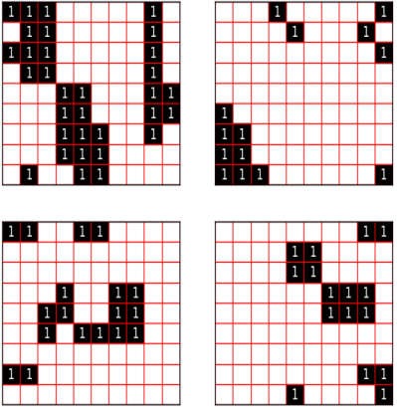
Binary Mask
Notes:
4-connectivity used.

Slide 14
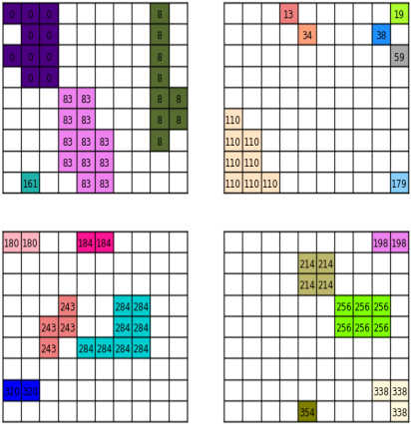
Stage 1 – Label in Chunk

Slide 15
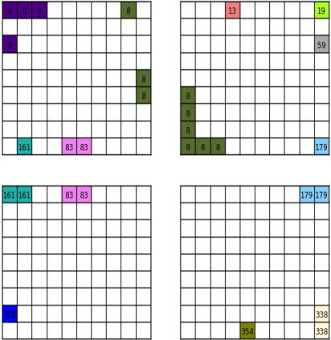
Stage 2 – Resolve Equivalence

Slide 16
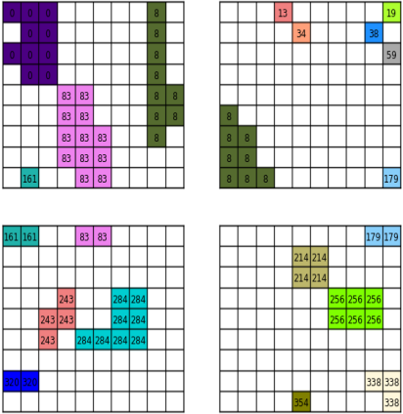
Stage 3 – Revise Labels

Slide 17
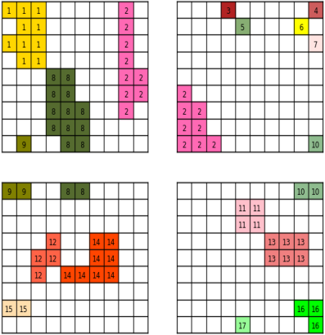
Stage 4 – Re-sequence Labels

Slide 18
Example
Blizzard-like snowstorm climatology based on NASA MERRA/-2

Slide 19
Blizzard-like Snowstorm
37 years of global MERRA (or 36 years of MERRA-2) hourly data are used.
Visibility is derived from snowfall rate and 2-m & 10-m wind speeds (Matsuzawa et al 2005).
Visibility criterion used to identify presence of blizzard-like snowstorms over land or land-ice surfaces.
CCL is applied to label individual episodes.

Slide 20
Performance
Wall time for each stage of CCL UDO (in seconds)
Stage | Number of Instances
 | 14 | 28 | 56 | 84
1 | 88-114 | 41-54 | 21-27 | 12-18
2a (replicate) | 9-12 | 7-9 | 6-12 | 6-14
2b (resolve) | 725-940 | 715-950 | 705-935 | 705-975
3 | 240-320 | 115-160 | 85-120 | 33-55
4 | 364-475 | 180-240 | 90-125 | 49-81
Notes:
This is our 4th implementation of CCL in SciDB. The table shows where improvements are needed to boost performance and scalability (i.e. stage 2).

Slide 21
36-year Average Unique Visit
Notes:
MERRA-2

Slide 22
36-year Average Snowfall
Notes:
MERRA-2, 36-year (1980-2015) average

Slide 23
36-year Average 10-m Wind

Slide 24
36-year Average Roughness Length

Slide 25
36-year Average Unique Visit

Slide 26
Acknowledgement
We are grateful for funding provided, primarily, by NASA Earth Science Technology Office (ESTO) through its Advanced Information Systems Technology (AIST) program and by the National Science Foundation (NSF) through the EarthCube program. The excellent computing support provided by NASA High End Computing (HEC) program through NASA Center for Climate Simulations (NCCS) is also acknowledged.

Slide 27
Thank you!

